Slide 1
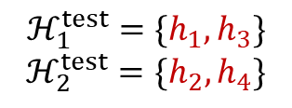
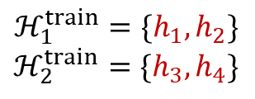
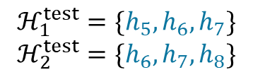
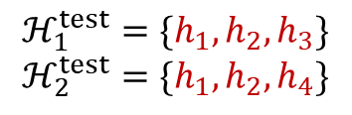
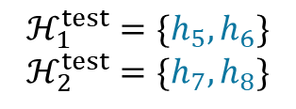
ID hypothesis class generalization
$$ℋ_{1}^{test}=\{h_{1},h_{3}\}$$
$$ℋ_{2}^{test}=\{h_{2},h_{4}\}$$
OOD hypothesis class generalization
$$ℋ_{1}^{test}=\{h_{5},h_{6}\}$$
$$ℋ_{2}^{test}=\{h_{7},h_{8}\}$$
$$ℋ_{1}^{train}=\{h_{1},h_{2}\}$$
$$ℋ_{2}^{train}=\{h_{3},h_{4}\}$$
ID hypothesis class size generalization
$$ℋ_{1}^{test}=\{h_{1},h_{2},h_{3}\}$$
$$ℋ_{2}^{test}=\{h_{1},h_{2},h_{4}\}$$
OOD hypothesis class size generalization
$$ℋ_{1}^{test}=\{h_{5},h_{6},h_{7}\}$$
$$ℋ_{2}^{test}=\{h_{6},h_{7},h_{8}\}$$

